Slide 1
Question about design of Future Smith + answers
Dejan
09/26/18

Slide 2
First of all, we’d better share the name convention of items on your project.
My suggestion from your requirement is:
1. Guest who doesn’t sign up. - Yes
2. Visitor for a tribe person/ member who has already signed up, but doesn’t join a tribe.
3. Tribe member for a tribe – Tribe is a group of tribe members. 1 member = 1 person.
4. Project member for a project. – Same logic as above. Project is a project that multiple people/ members can join.
5. Tribe owner who has created this tribe.
- Yes.
Is there another way to become a tribe owner except for creating tribe?
Yes, if they make someone else the tribe owner, i.e., pass the rights to someone else.
6. Project leader who has created this project. - Yes
Is there another way to become a project leader except for creating project? – Yes, if they make someone else the tribe owner, i.e., pass the rights to someone else.
7. Sponsor who donates. It doesn’t care about whether he doesn’t sign up or has signed up. – Yes, unless you think otherwise due to the logic.
Right?

Slide 3
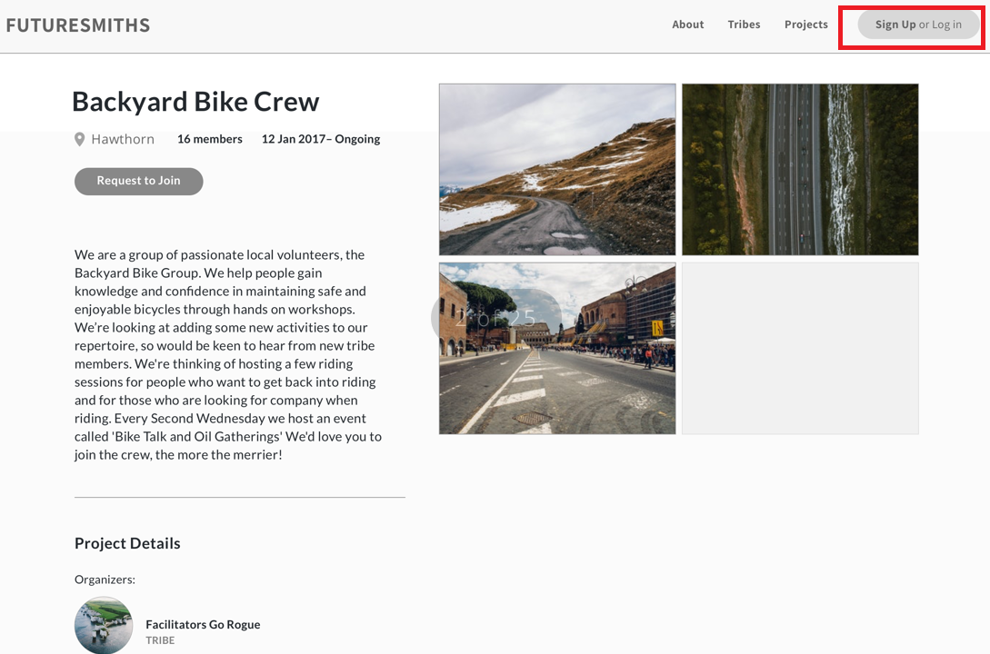
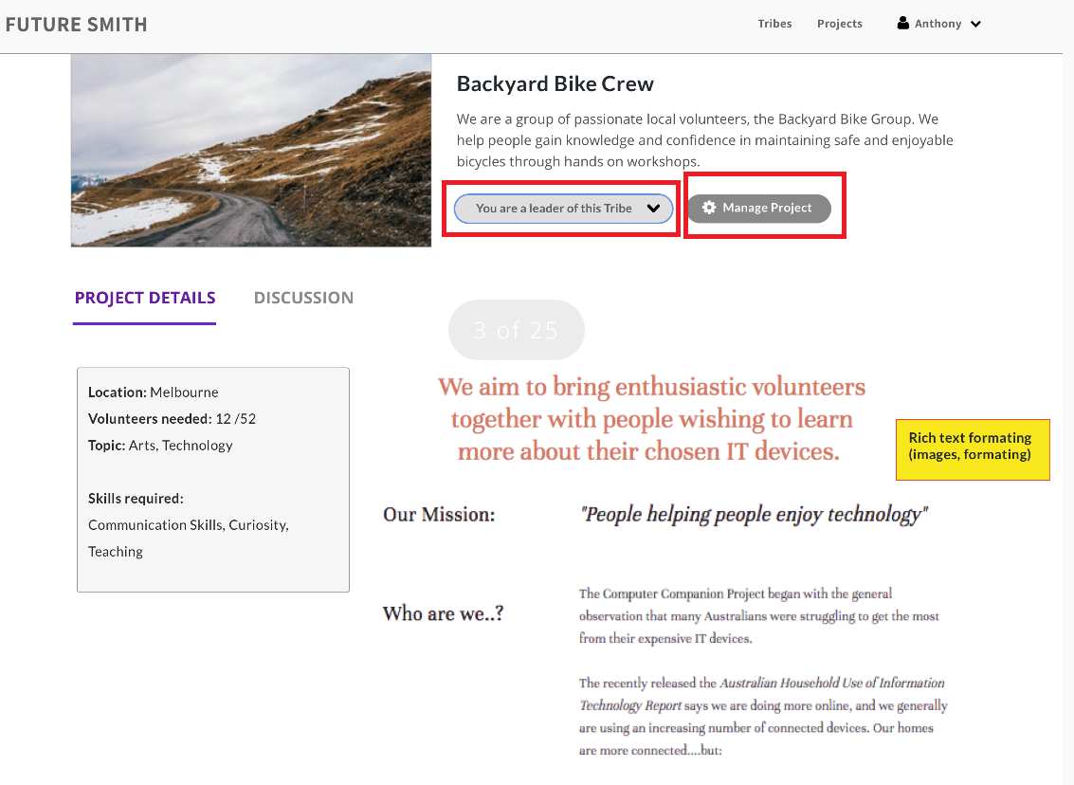
Q1: Project Detail (1)
These two designs are for ‘project details’. What are different from each other?
I think left one is for guest who doesn’t sign up and right one is for project member and project leader.
Right? - Correct

Slide 4
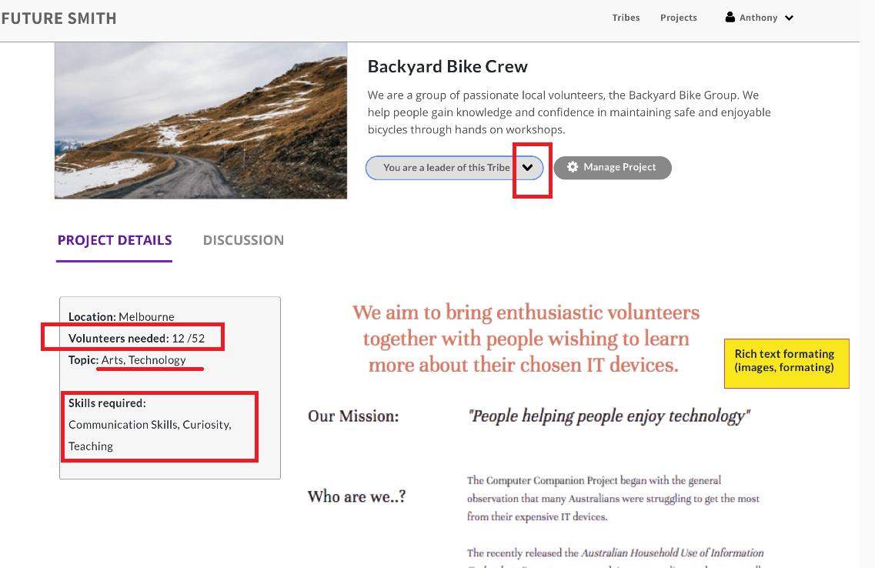
Q2: Project Detail (2)
2-1: The icon ‘You are a leader of this Tribe(May be Project)’ is just icon? Not button? Or is it drop down menu?
- It is a label with dropdown option “Leave this Project”. This will give an option to make someone else from the project members as the project owner before leaving.
2-2: I think the number of volunteers needed (for example below is 52) is inputted when you create a new project. Right? But I can’t see any design for creating or editing a project.
-This number is added in by the project owner when they create the project for the first time. Our current/ old design has this too (I am not sure if you are referring to the old website as well).
2-3: the topic for a project can be more than one? Not just one? – Yes, consider them as ‘tags’. One project can get tagged under multiple topics.
2-4: Skills also can be inputted on creating page. But I can’t see any design for creating or editing a project. – I think this exists in the current/ old design which is why the mockup isn’t there.

Slide 5
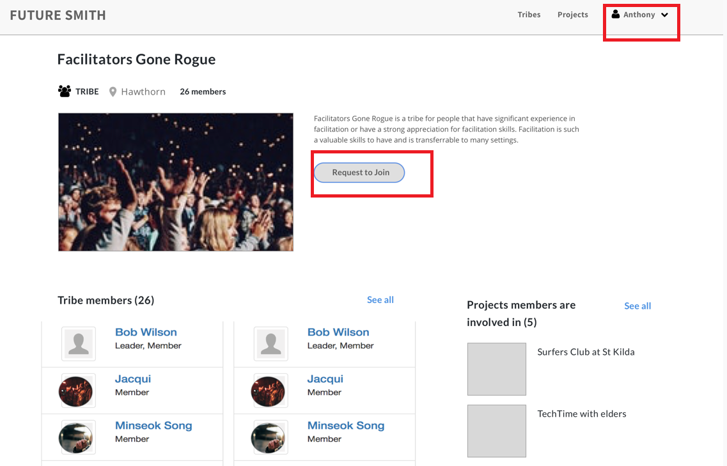
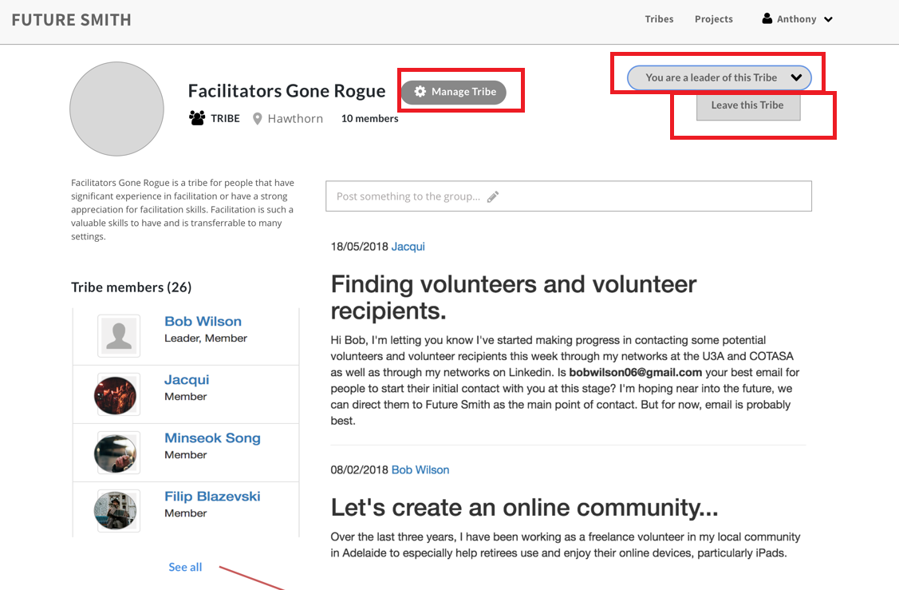
Q3: Tribe Detail (1)
3-1: left one is for a user who doesn’t has not yet joined this tribe, right one is for tribe member or tribe owner. Right? – Right one is for a Tribe Owner. But it will look similar for Tribe Member- they will have the ‘leave this tribe’ option, but no ‘Manage Tribe’ option.
3-2: in right picture, the button ‘leave this tribe’ is the child item of drop down menu from ‘you are a leader of this tribe’ icon?? Explain those buttons. – Sorry if it looks confusing! It is a label with a dropdown option to leave the Tribe. If you wish to replace it with another interaction pattern that makes this clearer, we are open to it.

Slide 6
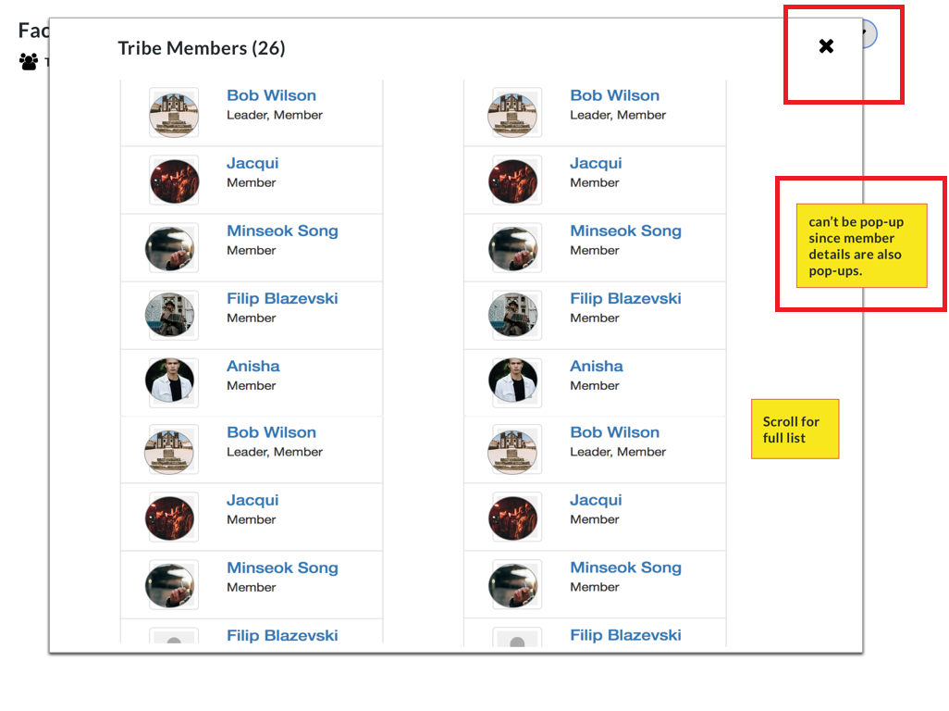
Q4: Tribe Detail (2)
4-1: you said this is not pop up dialog. Right? – Yes, this was an old design version. The comment in yellow was feedback that is yet to be incorporated in the mockup. Initial design shows list of members in pop-up. But this can be a problem, because clicking on the member name should show more information about that member. Perhaps the list of members can then be on a separate page? You have any suggestions?
4-2: if so, do I need to show member list on normal page when you click ‘see all’ button on previous tribe detail page?
- This is one option, yes. It might be too long if the list is long though.

Slide 7
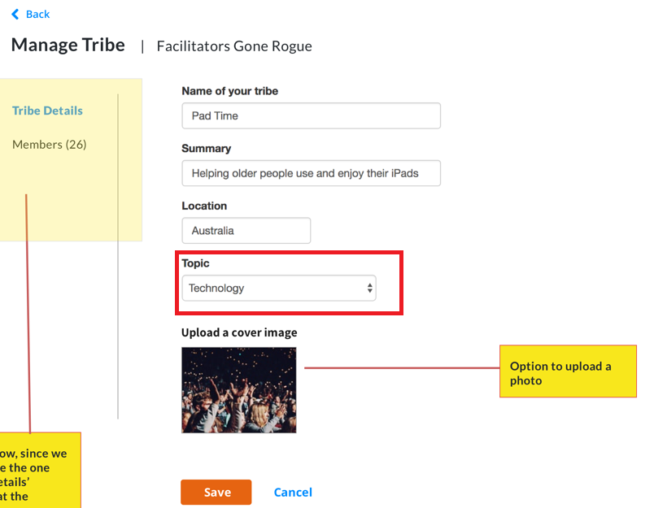
Q5: Tribe Edit (1)
5-1: can the topic for a tribe be more than one? Or just one? I already asked similar question about project topics.
We want to allow more than one topic to be associated with a project & allow adding more/ custom topics.
Tags seems to be a good solution to me. It will not be a dropdown like shown in the mockup in that case.

Slide 8
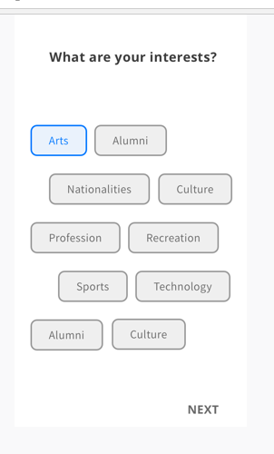
Q6: interest
6-1: it may be for mobile size, so what about full width page size design? I can’t see it.
- Ignore this for now. It is a redesign of the signup/ create profile flow.
6-2. when does it show? I don’t understand how I can be lead to this screen.
- During signup
6-3: what are different from term between ‘topic’, ‘skill’, ‘interest’?
Topic is like a theme of the project, eg- education, technology, entertainment etc.
Skill is the professional/ personal skills that individuals have that they can contribute to a project, eg- communication skills, leadership, coding skills, design skills, etc.
Interest is similar to topic. User adds Íntrests to their profile, and it matches with topics &/ or skills associated with a project. This is an old design, so if you see a cleaner solution, please go for it.

Slide 9
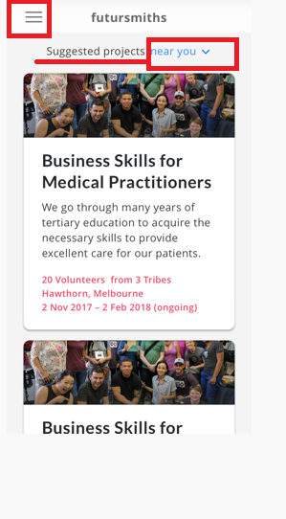
Q7: suggested projects near you
7-1: it may be for mobile size, so what about full width page size design? I can’t see it.
- This is a redesign for mobile of the Project list page. Please ignore for now. We can just make the current web page responsive.
7-2: what does it mean : ‘suggested projects near you’? How can I get those projects for a specific user?
- This suggestion is based on matching user’s interests with the topic/ skill associated with a project. - Else for now, we can do it just based on location– any projects in that location.
7-3: icon ‘near you’ is a drop down menu? What items can be in drop down menu?
User can type in location, and it will search there. Or another option is “”anywhere””
Eg- if I want to see in Sydney (but I live in Melbourne)

Slide 10
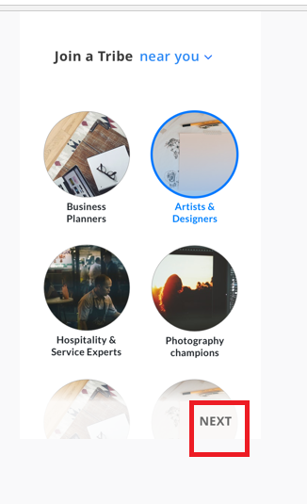
Q8: tribe near you
8-1: it may be for mobile size, so what about full width page size design? I can’t see it.
- Same as before--- this is meant to be a mobile-first redesign for tribe list page. Please ignore for now and let’s make the web page responsive.
8-2. when does it show? I don’t understand how I can be lead to this screen.
- Same page as Tribe list page.
8-3: what does it mean : ‘tribe near you’? How can I get those projects for a specific user?
- Shows Tribes based on users location.

Slide 11
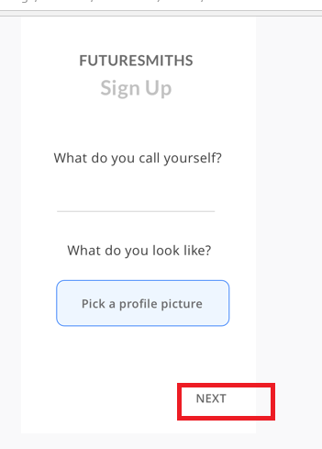
Q9: sign up (1)
9-1: it may be for mobile size, so what about full width page size design? I can’t see it.
- Same as before. Let’s leave the signup redesign for later. The basic functionality we have now should be ok. - Although we do need an option to allow user to upload a profile picture– this would be good.
9-2. when does it show? I don’t understand how I can be lead to this screen.
- same--- ignore for now.
9-3: all guests need to input their nickname with their avatar, right?
- Name &profile picture, yes. Our current basic functionality should cover this.

Slide 12
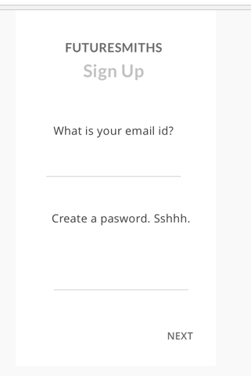
Q10: sign up (2)
10-1: it may be for mobile size, so what about full width page size design? I can’t see it.
- Same as before. Let’s leave the signup redesign for later. The basic functionality we have now should be ok.
10-2. when does it show? I don’t understand how I can be lead to this screen.
- Same as before. Let’s leave the signup redesign for later. The basic functionality we have now should be ok.

Slide 13
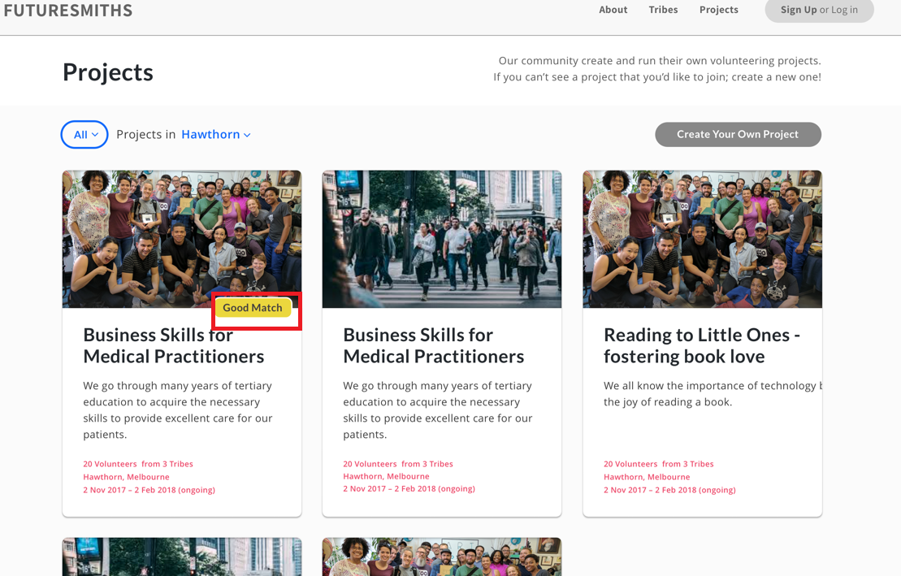
Q11: project list
11-1: how can I get ‘good match’ for a specific guest who doesn’t sign up and for any other user?
This was again based on matching member’s interests with projects having the same/ similar topic & skills.
It is like a recommendation/ suggestion.

Slide 14
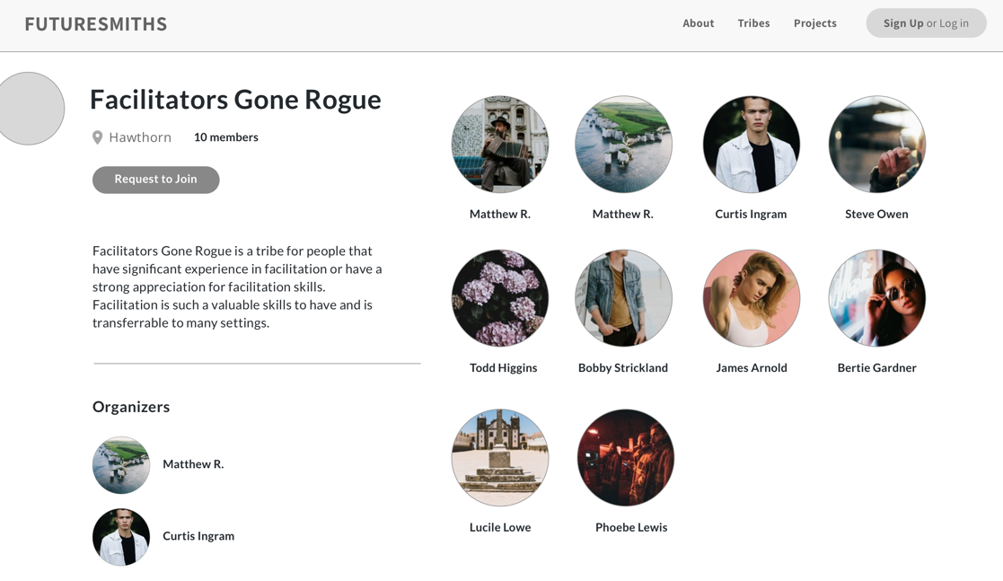
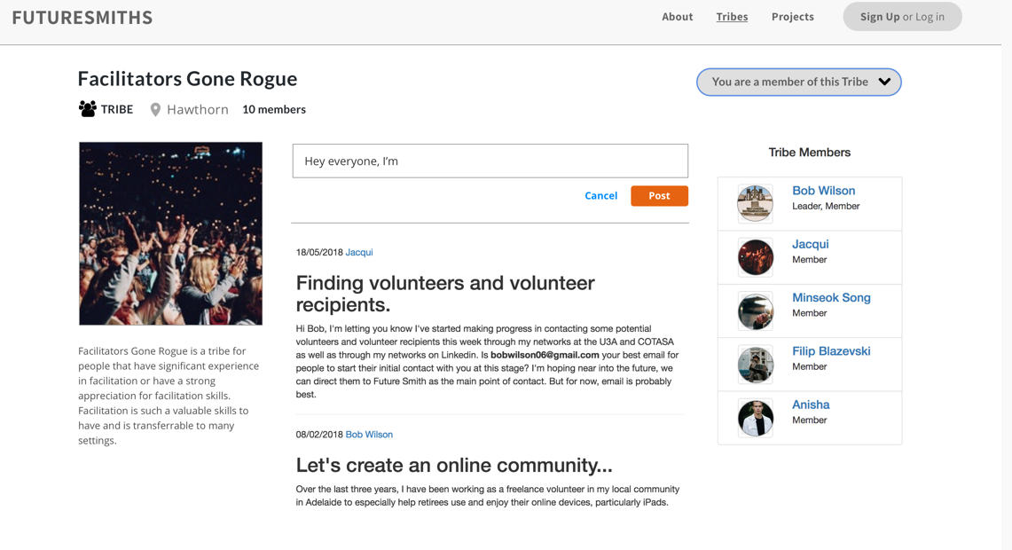
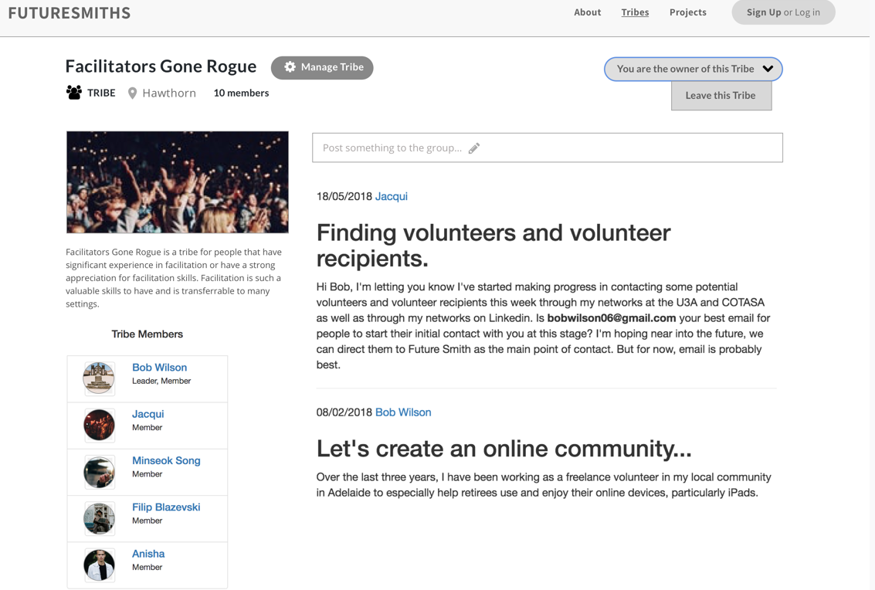
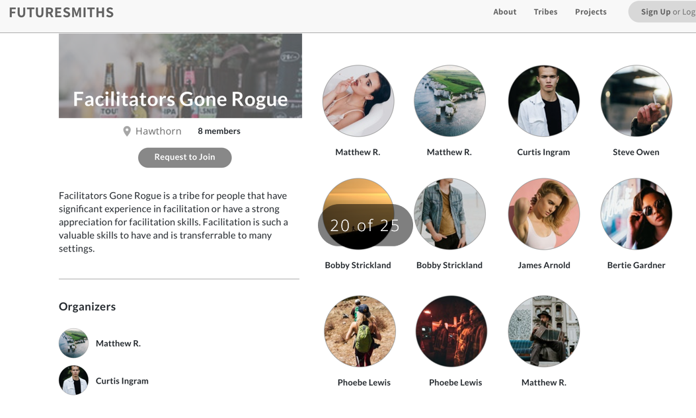
Q12: tribe details (3)
12-1: I am confused about several designs for tribe detail. Can you explain each design? Which one is for what? – These were different design iterations. Sorry that they all seem to have uploaded. I can understand why it is confusing. See the cross below.

Slide 15
Thanks for reviewing my foolish questions.
dejan

